Slide 1




DETECTION OF CRACKS
PRESENTED BY
S.Hema Sri
Y .Sai
P.Anil

Slide 2

Agenda
3
Introduction
8
Procedure
4
Reasons
9
Advantages
5
Statistics
10
Timeline
7
Objectives
11
Conclusion

Slide 3
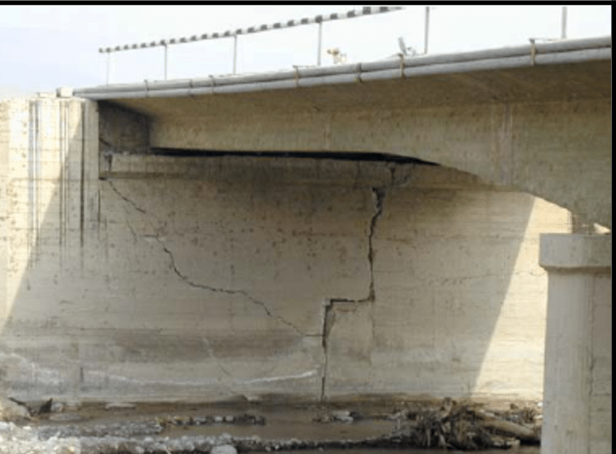

Introduction
Concrete cracking is a major issue in Bridge Engineering.
Detection of cracks facilitates the design, construction and maintenance of bridges effectively.
CRACK!!!

Slide 4

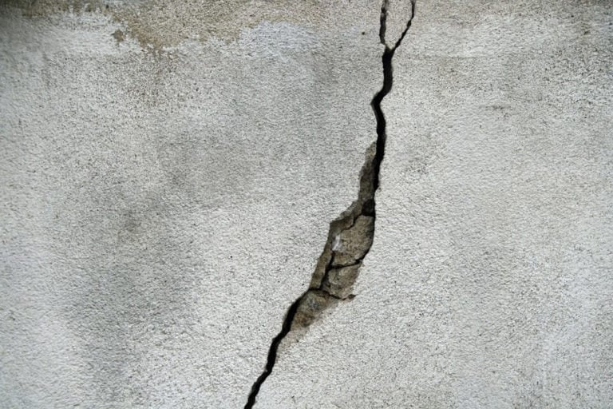

Reasons
Plastic Shrinkage
Loss of water by evaporation from the surface of newly laid concrete
Temperature Effects
The concrete temperature should be a minimum of 65°F and a maximum of 90°F
Autogeneous Shrinkage
Uniform reduction of internal moisture due to cement hydration
Drying Shrinkage
Occurs when water starts evaporating from the exposed surface and the moisture differential along the depth of the slab causes strain which induces tensile stresses

Slide 5


Statistics
Severity rating | Description
1 | New bridge
2 | 0 < 0.3 mm wide
3 | 0.3 to 3 mm wide
4 | > 3 mm wide
5 | Bridge closed

Slide 6
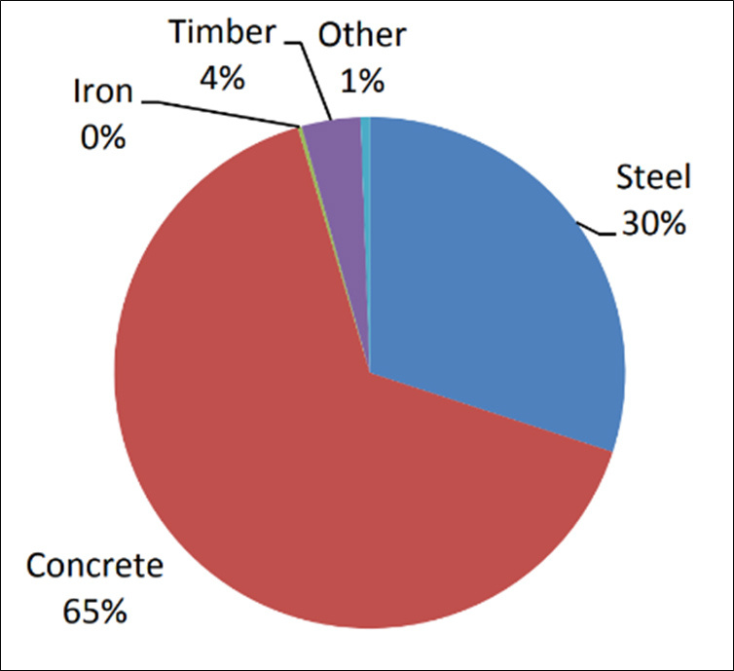

In 2013 studies,the material types of the failed bridges during construction and found that the failed steel bridges accounted for about 40% while concrete bridges for about 52%.
Life loss occurred on about 4% of bridge collapses.
Distribution of Failure by Material Used

Slide 7
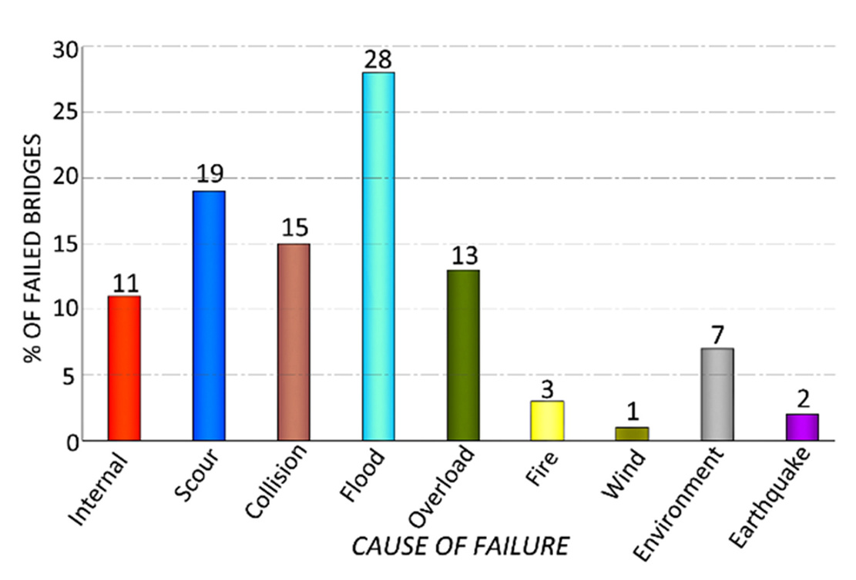
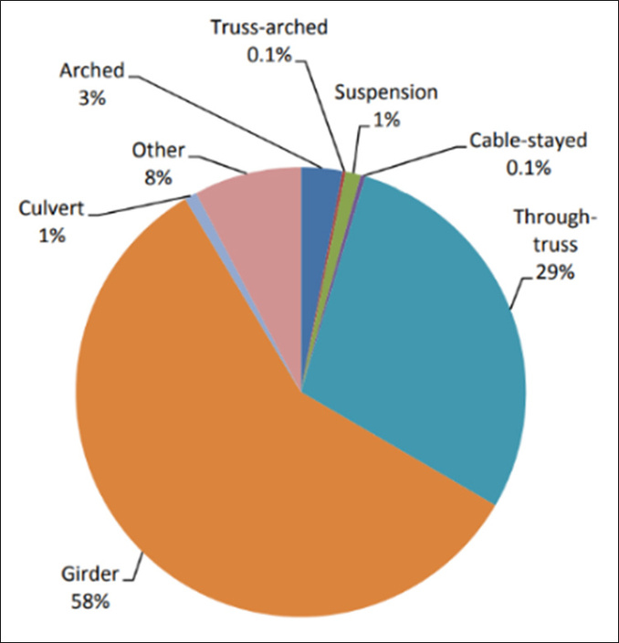
% of Failed Bridges based on Cause of Failure
Distribution of Failure by Structure Type

Slide 8
We can reduce concrete cracks
structural health and ensuring structural safety
Objectives
Every task will ensure a positive outcome !!
Reduce Accidents

Slide 9
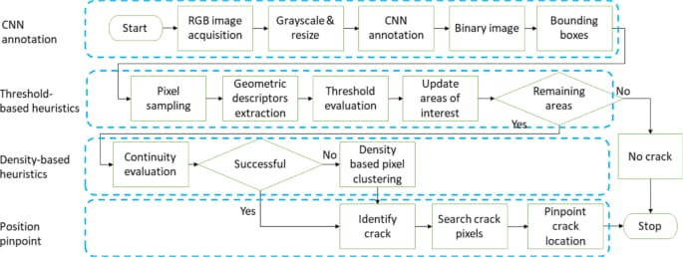

Procedure !!

Slide 10

Advantages
1 | It provides accurate result compared to the conventional manual methods.
2 | Crack detection is an important work of engineering quality assessment.
3 | If the cracks of concrete structures are not treated in time, it may cause severe safety accidents.
4 | Detection of cracks leads to decrease in bridge failures.

Slide 11
Proposed Timeline
07 Jan 23
09 Jan 23
11 Jan 23
13 Jan 23
Time management every where and anywhere produces a great result.
Problem identification
Research on Concrete Cracks
Searching for best deep learning techniques
Testing with Various Inputs

Slide 12
Conclusion
It provides accurate result compared to the conventional manual methods
crack detection is an important work of engineering quality assessment
If the cracks of concrete structures are not treated in time, it may cause severe safety accidents.
Detection of cracks leads to decrease in bridge failures

Slide 13
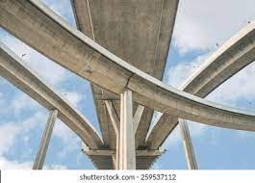
Thank
you!

